Slide 1
Software Engineering (Principles, Policies & Guidelines) in a Tech-Driven World (Automating Excellence) 07th February 2024
WHY, WHAT and HOW
Fahad Anwar
Notes:
Overview: An inclusive approach of defining software engineering principles/policies and the plan to leverage advanced technologies and tools to automate the implementation of these principles and policies.​

Slide 2
WHY Software Engineering Principles/Policies…

Slide 3
WHY Software Engineering Principles/Policies…
Purpose (ONS technical strategy)
To enable innovation at speed and scale which will keep the ONS providing high quality data and analysis to shape the UK, improve lives and build the future.

Slide 4
WHY Software Engineering Principles/Policies…
Purpose (ONS technical strategy)
To enable innovation at speed and scale which will keep the ONS providing high quality data and analysis to shape the UK, improve lives and build the future.

Slide 5
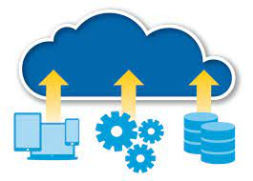

WHY Software Engineering Principles/Policies…
Purpose (ONS technical strategy)
To enable innovation at speed and scale which will keep the ONS providing high quality data and analysis to shape the UK, improve lives and build the future.
Purpose (ONS technical strategy)
To enable innovation at speed and scale which will keep the ONS providing high quality data and analysis to shape the UK, improve lives and build the future.
Key Principles of ONS Technical Strategy
Move to Cloud
Everything as a Service

Slide 6

WHY Software Engineering Principles/Policies…
Purpose (ONS technical strategy)
To enable innovation at speed and scale which will keep the ONS providing high quality data and analysis to shape the UK, improve lives and build the future.
Purpose (ONS technical strategy)
To enable innovation at speed and scale which will keep the ONS providing high quality data and analysis to shape the UK, improve lives and build the future.
Key Principles of ONS Technical Strategy
Move to Cloud
Everything as a Service
Empowerment

Slide 7
WHY Software Engineering Principles/Policies…
Innovation at speed and scale

Slide 8
WHY Software Engineering Principles/Policies…
Consistency
Standardisation
Compliance
Risk management
Documentation
Communication
Accountability
Continuous improvement
Innovation at speed and scale
Innovation at speed and scale

Slide 9
WHY Software Engineering Principles/Policies…
Software Engineering Policies
Consistency
Standardisation
Compliance
Risk management
Documentation
Communication
Accountability
Continuous improvement
Innovation at speed and scale
Innovation at speed and scale
Sustainable
Accelerate

Slide 10
WHY Software Engineering Principles/Policies…
Software Engineering Policies
Consistency
Standardisation
Compliance
Risk management
Documentation
Communication
Accountability
Continuous improvement
Innovation at speed and scale
Innovation at speed and scale
Sustainable
Accelerate
Software Engineering Policies to ensure
sustainable “innovation at speed and scale” with governance

Slide 11
Software Development Principles, Policies, Guidelines… WHAT

Slide 12
Consultation Process to define Software Engineering Principles/Policies, Guidelines…

Slide 13
Consultation Process to define Software Engineering Principles/Policies, Guidelines…
Technical Advisory Group (TAG)
Comprising members from the Software Engineering, DevSecOps, Testing, and Security professions

Slide 14
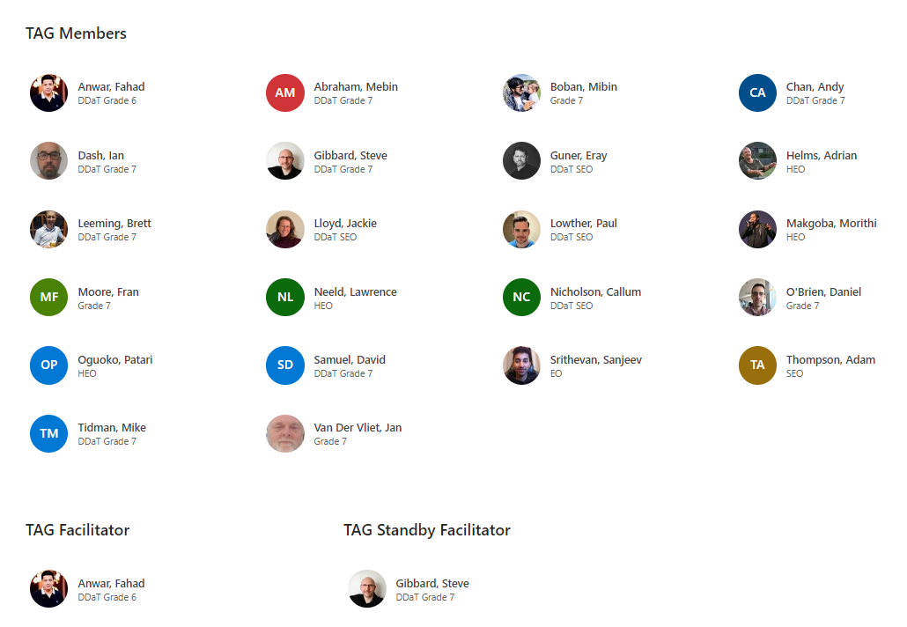
Consultation Process to define Software Engineering Principles/Policies, Guidelines…
Technical Advisory Group (TAG)
Comprising members from the Software Engineering, DevSecOps, Testing, and Security professions

Slide 15
WHAT- Defining SE-PPG though Technical Advisory Group (TAG)

Slide 16
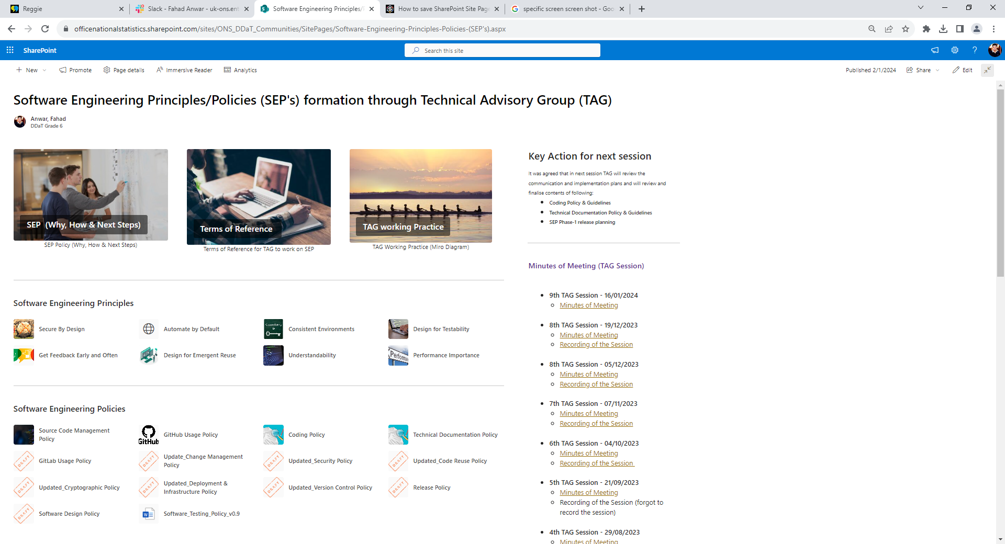
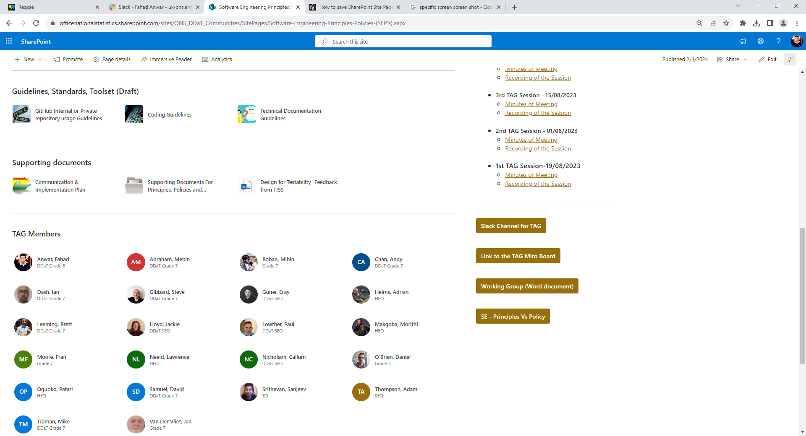
WHAT- Defining SE-PPG though Technical Advisory Group (TAG)
Strategy
Principles
Implementation Plan through Automation
Policies
Guidelines

Slide 17
Software Development Principles, Policies, Guidelines… HOW

Slide 18
HOW (Approach) Software Engineering Principles/Policies, Guidelines…
Culture
Process/Procedures
Software Engineering Policies

Slide 19
HOW (Approach) Software Engineering Principles/Policies, Guidelines…
Culture
Conflict
Process/Procedures
Software Engineering Policies
Innovation at speed and scale
Notes:
Development teams enabling cloud adoption must enable rapid innovation while implementing governance, security and compliance controls. These two goals often conflict because traditional approaches are controls stifle speed and agility, however through use of technology/tools we can implementation of software engineering principles/policies without compromising on speed and agility.

Slide 20
HOW (Approach) Software Engineering Principles/Policies, Guidelines…
Technology
Culture
Conflict
Process/Procedures
Software Engineering Policies
Innovation at speed and scale
Notes:
Development teams enabling cloud adoption must enable rapid innovation while implementing governance, security and compliance controls. These two goals often conflict because traditional approaches are controls stifle speed and agility, however through use of technology/tools we can implementation of software engineering principles/policies without compromising on speed and agility.

Slide 21
HOW (Approach) Software Engineering Principles/Policies, Guidelines…
Technology
Technology is used to implement SEP
Automation
CI/CD
Templating
Scaffolding
Automated non-functional testing
etc
Culture
Conflict
Process/Procedures
Software Engineering Policies
Innovation at speed and scale
Notes:
Development teams enabling cloud adoption must enable rapid innovation while implementing governance, security and compliance controls. These two goals often conflict because traditional approaches are controls stifle speed and agility, however through use of technology/tools we can implementation of software engineering principles/policies without compromising on speed and agility.

Slide 22
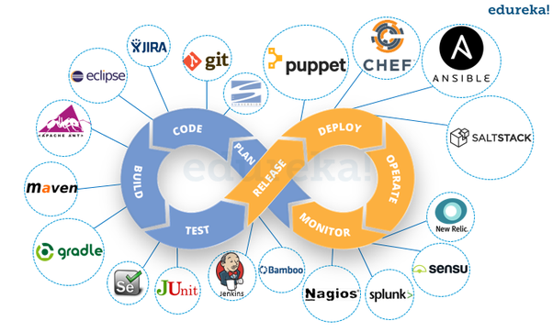
HOW (Approach) - SEP (use of technology)…Continue
Software Engineering Policies/Guidelines
This Photo by Unknown Author is licensed under CC BY-SA-NC

Slide 23
HOW (Approach) - SEP (use of technology)…Continue
Software Engineering Policies/Guidelines
Cognitive Load for developers
Understand all different technologies
Time effort required to maintain them
This Photo by Unknown Author is licensed under CC BY-SA-NC

Slide 24

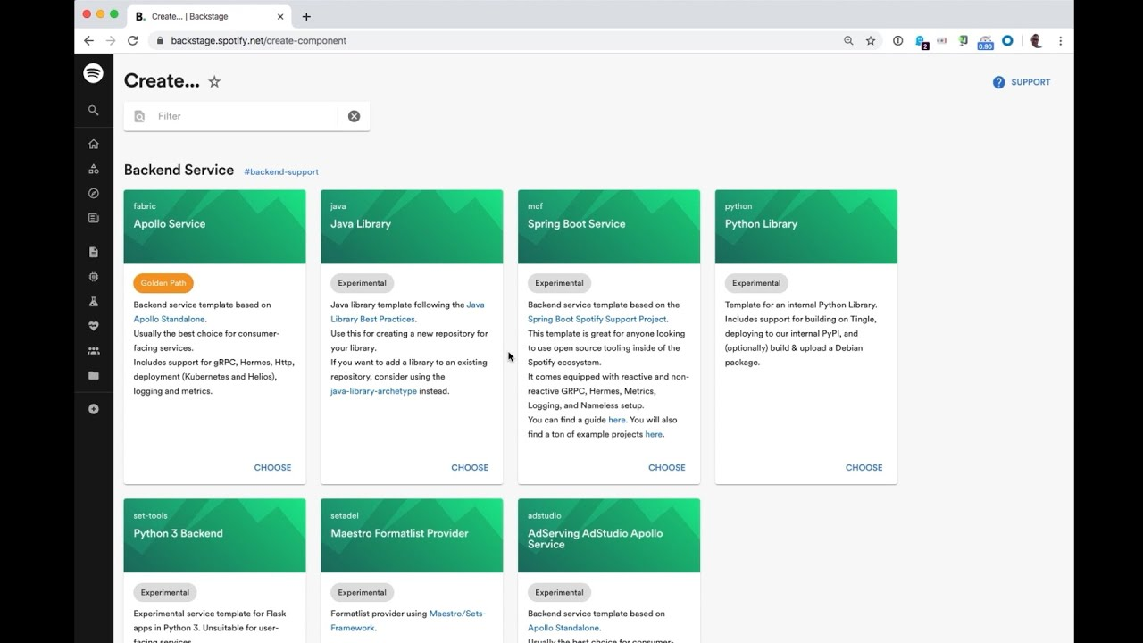
HOW (Approach) - SEP (use of technology)…Continue
Software Engineering Policies/Guidelines
By 2025, 75% of organisations with platform teams will provide self-service developer portals to improve developer experience and accelerate product innovation (Gartner Report 2022).
Unifies infrastructure tooling, services, training, observability, cost tracking, infrastructure scaffolding, and documentation into a single streamlined development interface.
Build from the templates
Ensure the code quality and structure as per Coding Policy/Guidelines
Approved libraries are used (quality policy/Guidelines)
Create a GitHub repository and assign securities as per (security/ source control policy)
Cloud Infrastructure is source automatically covering the Infrastructure & Deployment Policy (including different environment for testing and production)
Test data and integration tests are setup (quality policy, security policy)
Software Developers Portal
Cognitive Load for developers
Understand all different technologies
Time effort required to maintain them
This Photo by Unknown Author is licensed under CC BY-SA-NC

Slide 25
Software Developer Portal Demo (use cases)
HOW (Approach) - SEP (use of technology)…Continue

Slide 26
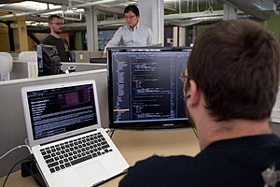
I have all these Software Development Policies, Standards and Guidelines to follow in my software development.
can anybody do this for me automatically?
This Photo by Unknown Author is licensed under CC BY-SA

Slide 27

I have all these Software Development Policies, Standards and Guidelines to follow in my software development.
can anybody do this for me automatically?
Is there a way for me to easily access information
about the Services, API my team is working on, the infrastructure being used and the available documentation?
This Photo by Unknown Author is licensed under CC BY-SA
This Photo by Unknown Author is licensed under CC BY-SA-NC

Slide 28
I have all these Software Development Policies, Standards and Guidelines to follow in my software development.
can anybody do this for me automatically?
Is there a way for me to easily access information
about the Services, API my team is working on, the infrastructure being used and the available documentation?
I need to write ADR as per Technical Documentation Policy, is that can be done through SDP and become part of documentation automatically
This Photo by Unknown Author is licensed under CC BY-SA
This Photo by Unknown Author is licensed under CC BY-SA-NC

Slide 29
I have all these Software Development Policies, Standards and Guidelines to follow in my software development.
can anybody do this for me automatically?
Is there a way for me to easily access information
about the Services, API my team is working on, the infrastructure being used and the available documentation?
I need to use Redis database for this project, can I know if any other team has used it and discuss the existing approach
I need to write ADR as per Technical Documentation Policy, is that can be done through SDP and become part of documentation automatically
This Photo by Unknown Author is licensed under CC BY-SA
This Photo by Unknown Author is licensed under CC BY-SA-NC

Slide 30

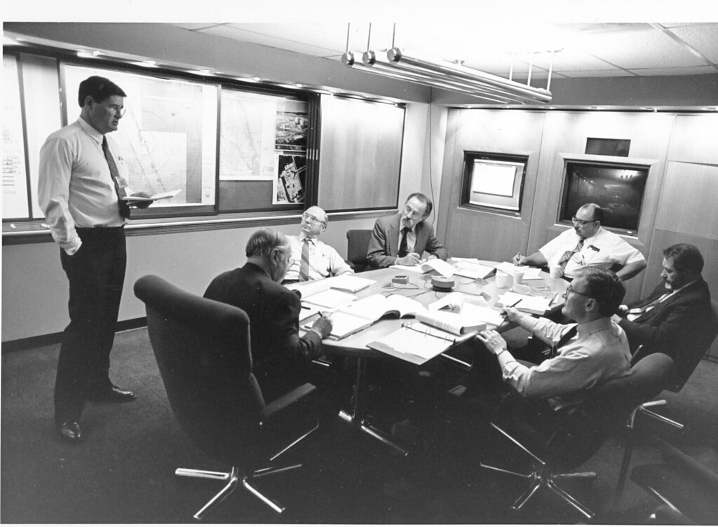
Can I know what specific programming languages, tools and framework are in use, and in which project?
This Photo by Unknown Author is licensed under CC BY-NC-ND
This Photo by Unknown Author is licensed under CC BY

Slide 31
Can I know which team owns what Services, Website, Library etc?
Can I know what specific programming languages, tools and framework are in use, and in which project?
This Photo by Unknown Author is licensed under CC BY-NC-ND
This Photo by Unknown Author is licensed under CC BY

Slide 32
Can I know which team owns what Services, Website, Library etc?
Can I know what specific programming languages, tools and framework are in use, and in which project?
Ok, so we have all this information available in SDP, can I just Ask it and it tells me?
This Photo by Unknown Author is licensed under CC BY-NC-ND
This Photo by Unknown Author is licensed under CC BY

Slide 33
Can I know which team owns what Services, Website, Library etc?
Can I know what specific programming languages, tools and framework are in use, and in which project?
We have so many repositories/ systems, it will take lot of time/effort to bring them all under SDP?
Ok, so we have all this information available in SDP, can I just Ask it and it tells me?
This Photo by Unknown Author is licensed under CC BY-NC-ND
This Photo by Unknown Author is licensed under CC BY

Slide 34
Q & A

